Slide 1
SNACK SQUAD: A CUSTOMIZABLE SNACK ORDERING AND DELIVERY APP
Submitted by:
Santhosh .R
Sabhareesan .G
Prasanna .P
Nithees Kumar . M

Slide 2
Description
A project that demonstrates the use of Android Jetpack Compose to build a UI for a snack squad app. Snack Squad is a sample project built using the Android Compose UI toolkit. It demonstrates how to create a simple e-commerce app for snacks using the Compose libraries.The user can see a list of snacks, and by tapping on a snack,and by tapping on the "Add to Cart" button, the snack will be added to the cart. The user can also see the list of items in the cart and can proceed to checkout to make the purchase.

Slide 3
Required Depedencies
Backend: Node.js with Express or Django (API handling)
Database: MongoDB or Firebase (real-time data and user preferences)
Real-Time Tracking: Google Maps API (for delivery tracking)
Notifications: Firebase Cloud Messaging or OneSignal (push notifications)
Payments: Stripe, PayPal, or Apple Pay/Google Pay integration (secure transactions)
Frontend: React Native (for cross-platform mobile app)

Slide 4
User Profiles & Preferences
Users can save favorite snack combinations for quick reordering.
Option to set preferred delivery times or recurring orders.
Snack Customization
Wide selection of snack categories: chips, nuts, fruits, sweets, baked goods, beverages, etc.
Options to select portion sizes, flavors, and toppings.
Customizable bundles, like "Build Your Own Snack Box."
Real-Time Nutritional Information
Display nutritional info for each snack item and bundle.
Dietary filters and allergen alerts.
Real-time updates to nutritional info as items are added or customized.

Slide 5
Program code:
Package com.example.snacksquad•
import android.os.Bundle•
import androidx.activity.viewModels•
import androidx.appcompat.app.AppCompatActivity
import androidx.recyclerview.widget.LinearLayoutManager
import androidx.recyclerview.widget.RecyclerView
import com.example.snacksquad.database.Snack
import com.example.snacksquad.database.SnackViewModel
class MainActivity : AppCompatActivity()
private lateinit var snackViewModel: SnackViewModel
private lateinit var snackRecyclerView:
private lateinit var snackAdapter: SnackAdapter

Slide 6
plugins {
id 'com.android.application'
id 'org.jetbrains.kotlin.android'
}
android {
namespace 'com.example.snackordering'
compileSdk 33
defaultConfig {
applicationId "com.example.snackordering"
minSdk 24
targetSdk 33
versionCode 1
versionName "1.0"

Slide 7
testInstrumentationRunner "androidx.test.runner.AndroidJUnitRunner"
vectorDrawables {
useSupportLibrary true
}
}
buildTypes {
release {
minifyEnabled false
proguardFiles getDefaultProguardFile('proguard-android-optimize.txt'), 'proguard-rules.pro'
}
}
compileOptions {
sourceCompatibility JavaVersion.VERSION_1_8
targetCompatibility JavaVersion.VERSION_1_8
}

Slide 8
kotlinOptions {
jvmTarget = '1.8'
}
buildFeatures {
compose true
}
composeOptions {
kotlinCompilerExtensionVersion '1.2.0'
}
packagingOptions {
resources {
excludes += '/META-INF/{AL2.0,LGPL2.1}'
}
}
}

Slide 9
dependencies {
implementation 'androidx.core:core-ktx:1.7.0'
implementation 'androidx.lifecycle:lifecycle-runtime-ktx:2.3.1'
implementation 'androidx.activity:activity-compose:1.3.1'
implementation "androidx.compose.ui:ui:$compose_ui_version"
implementation "androidx.compose.ui:ui-tooling-preview:$compose_ui_version"
implementation 'androidx.compose.material:material:1.2.0'
implementation 'androidx.room:room-common:2.5.0'
implementation 'androidx.room:room-ktx:2.5.0'
testImplementation 'junit:junit:4.13.2'
androidTestImplementation 'androidx.test.ext:junit:1.1.5'
androidTestImplementation 'androidx.test.espresso:espresso-core:3.5.1'
androidTestImplementation "androidx.compose.ui:ui-test-junit4:$compose_ui_version"
debugImplementation "androidx.compose.ui:ui-tooling:$compose_ui_version"
debugImplementation "androidx.compose.ui:ui-test-manifest:$compose_ui_version"
}

Slide 10
Snack Adapter
class SnackAdapter :
RecyclerView.Adapter<SnackAdapter.SnackViewHolder>() {
private var snacks = emptyList<Snack>()
SnackViewHolder(itemView: View)RecyclerView.ViewHolder(itemView) • { • val snack Name: TextView = itemView.findViewById(R.id.snack_name)
val snackPrice: TextView = itemView.findView•
}
}

Slide 11
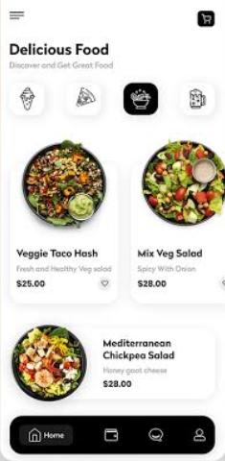
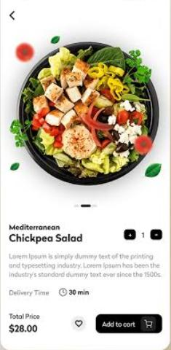
Output:

